Slide 1
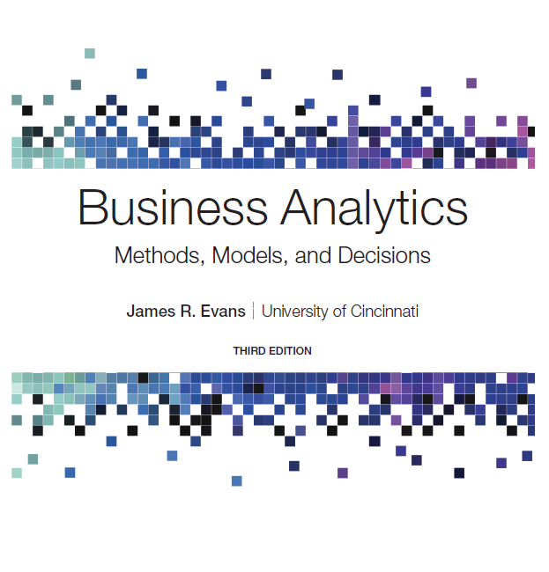
Business Analytics: Methods, Models, and Decisions
Third Edition
Chapter 8
Trendlines and Regression Analysis
Copyright © 2020, 2016, 2013 Pearson Education, Inc. All Rights Reserved
Notes:
If this PowerPoint presentation contains mathematical equations, you may need to check that your computer has the following installed:
1) MathType Plugin
2) Math Player (free versions available)
3) NVDA Reader (free versions available)

Slide 2
Modeling Relationships and Trends in Data
Create charts to better understand data sets.
For cross-sectional data, use a scatter chart.
For time series data, use a line chart.

Slide 3
Common Mathematical Functions Used n Predictive Analytical Models
Linear
Logarithmic
Polynomial (2nd order)
Polynomial (3rd order)
Power
Exponential
(the base of natural logarithms,
is often
used for the constant b)

Slide 4
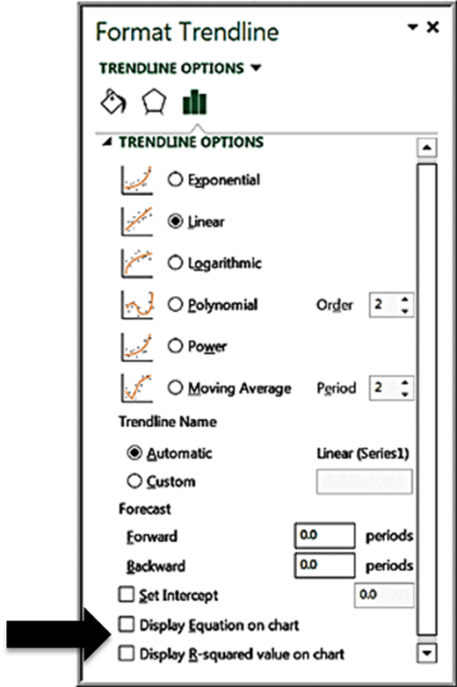
Excel Trendline Tool
Right click on data series and choose Add trendline from pop-up menu.
Check the boxes Display Equation on chart and Display R-squared value on chart.

Slide 5
R Squared
(R-squared) is a measure of the “fit” of the
line to the data.
The value of
will be between 0 and 1.
A value of 1.0 indicates a perfect fit and all
data points would lie on the line; the larger the
value of
the better the fit.

Slide 6
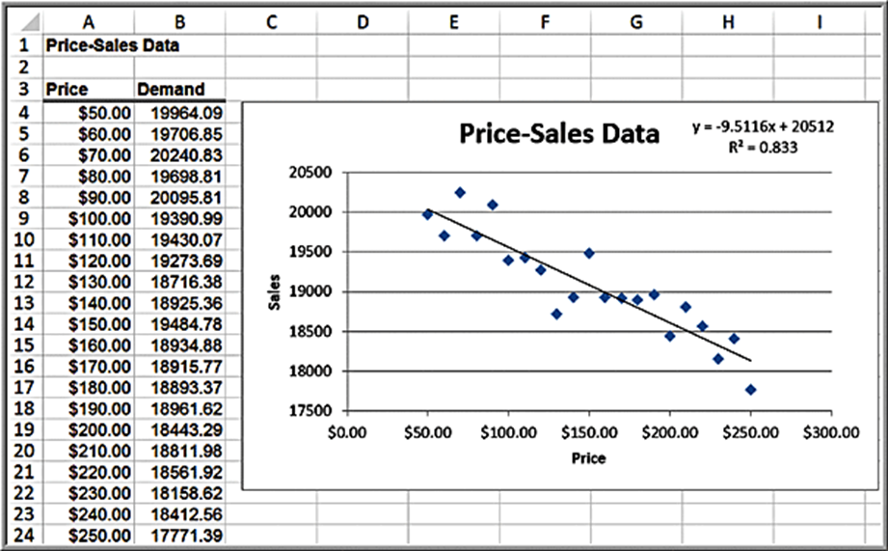
Example 8.1: Modeling a Price-Demand Function
Linear demand function:

Slide 7
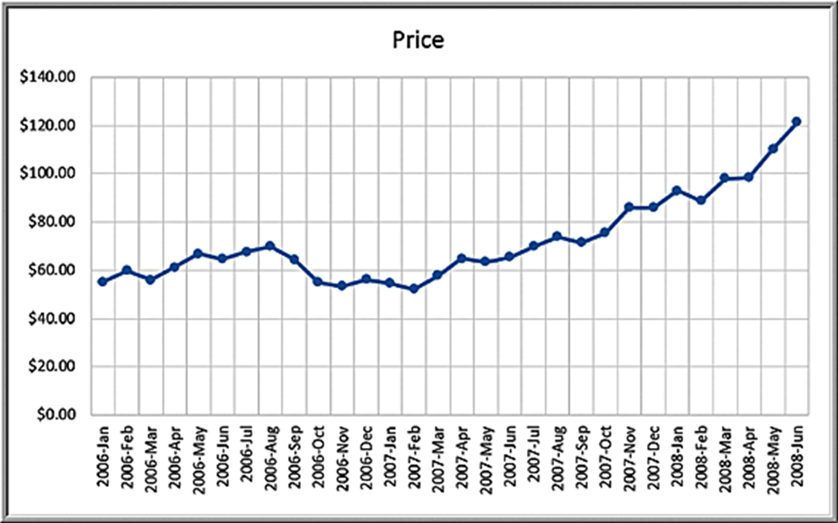
Example 8.2: Predicting Crude Oil Prices (1 of 3)
Line chart of historical crude oil prices

Slide 8
Example 8.2: Predicting Crude Oil Prices (2 of 3)
Excel’s Trendline tool is used to fit various functions to the data.
Exponential
Logarithmic
Polynomial 2°
Polynomial 3°
Power

Slide 9
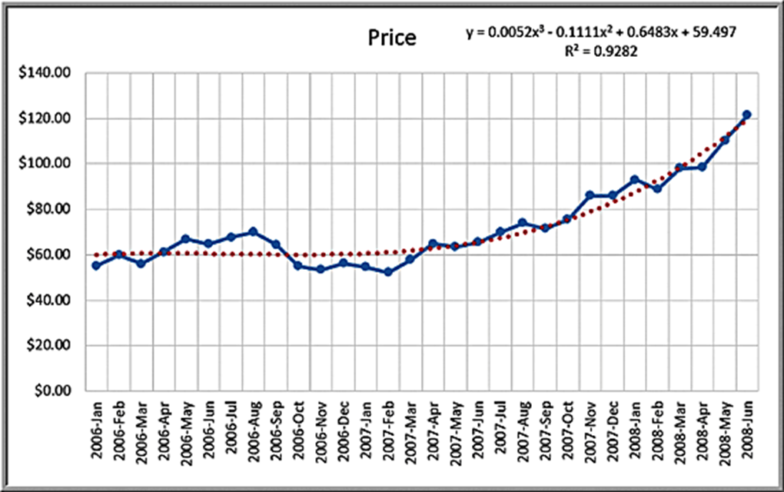
Example 8.2: Predicting Crude Oil Prices (3 of 3)
Third order polynomial trendline fit to the data

Slide 10
Caution About Polynomials
The
value will continue to increase as the order of the
polynomial increases; that is, a 4th order polynomial will provide a better fit than a 3rd order, and so on.
Higher order polynomials will generally not be very smooth and will be difficult to interpret visually.
Thus, we don’t recommend going beyond a third-order polynomial when fitting data.
Use your eye to make a good judgment!

Slide 11
Regression Analysis
Regression analysis is a tool for building mathematical and statistical models that characterize relationships between a dependent (ratio) variable and one or more independent, or explanatory variables (ratio or categorical), all of which are numerical.
Simple linear regression involves a single independent variable.
Multiple regression involves two or more independent variables.

Slide 12
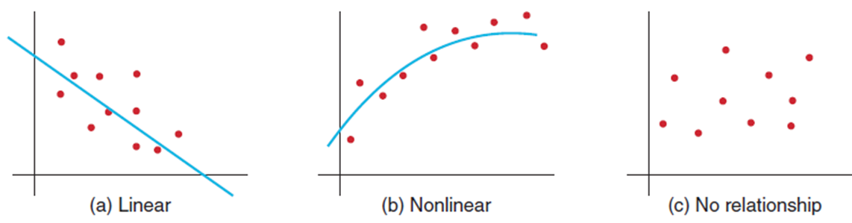
Simple Linear Regression
Finds a linear relationship between:
one independent variable X and
one dependent variable Y
First prepare a scatter chart to verify the data has a linear trend.
Use alternative approaches if the data is not linear.

Slide 13
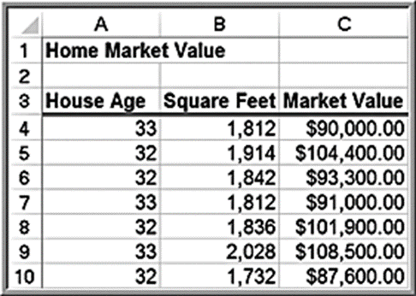
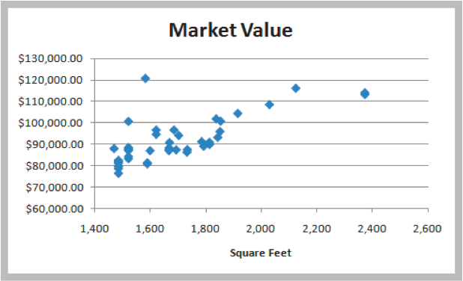
Example 8.3: Home Market Value Data
Size of a house is typically related to its market value.
X = square footage
Y = market value ($)
The scatter chart of the full data set (42 homes) indicates a linear trend.

Slide 14
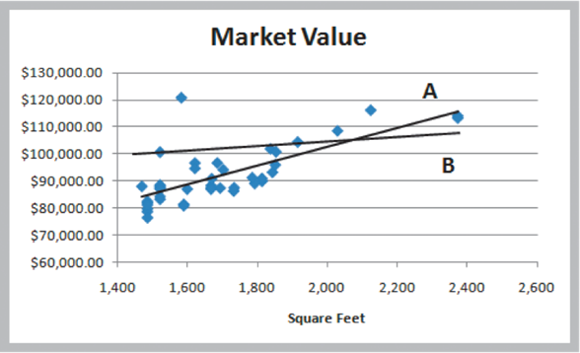
Finding the Best-Fitting Regression Line
Market value
Two possible lines are shown below.
Line A is clearly a better fit to the data.
We want to determine the best regression line.

Slide 15
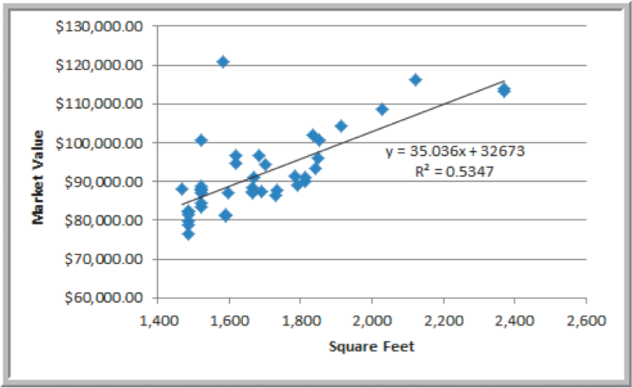
Example 8.4: Using Excel to Find the Best Regression Line
Market value
The estimated market value of a home with 2,200 square feet
would be: market value
The regression model explains variation in market value due to size of the home.
It provides better estimates of market value than simply using the average.

Slide 16
Least-Squares Regression
Simple linear regression model:
We estimate the parameters from the sample data:
Let
be the value of the independent variable of the
observation. When the value of the independent
variable is
then
is the estimated value
of Y for

Slide 17
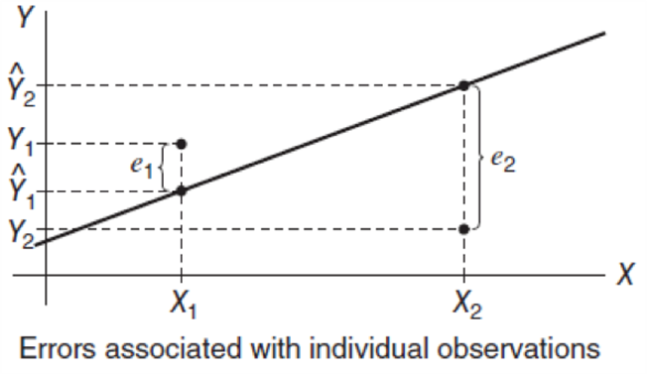
Residuals
Residuals are the observed errors associated with estimating the value of the dependent variable using the regression line:

Slide 18
Least Squares Regression
The best-fitting line minimizes the sum of squares of the residuals.
Excel functions:

Slide 19

Example 8.5: Using Excel Functions to Find Least-Squares Coefficients
Estimate Y when X = 1750 square feet

Slide 20
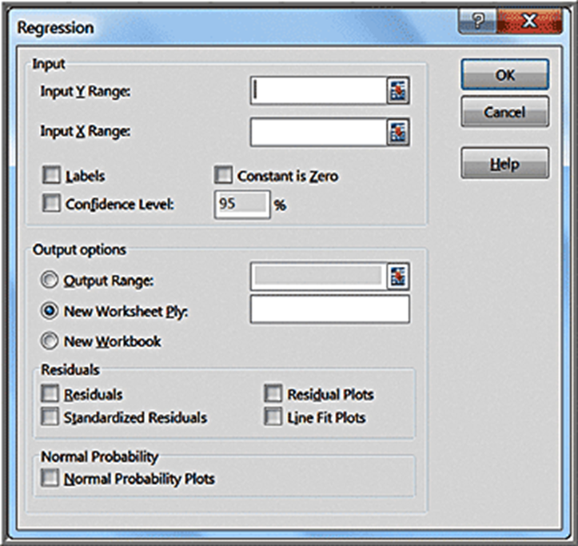
Simple Linear Regression with Excel
Input Y Range (with header)
Input X Range (with header)
Check Labels box
Excel outputs a table with many useful regression statistics.

Slide 21
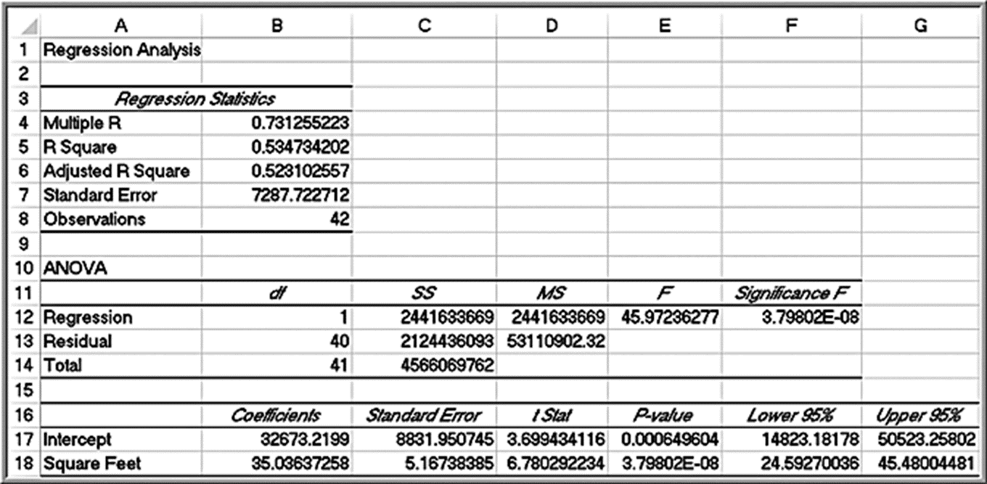
Home Market Value Regression Results

Slide 22
Regression Statistics
Multiple R -
where r is the sample correlation coefficient. The
value of r varies from −1 to +1 (r is negative if slope is negative)
R Square - coefficient of determination,
which varies from
0 (no fit) to 1 (perfect fit)
Adjusted R Square - adjusts
for sample size and number of X
variables
Standard Error - variability between observed and predicted Y values.
This is formally called the standard error of the estimate,

Slide 23
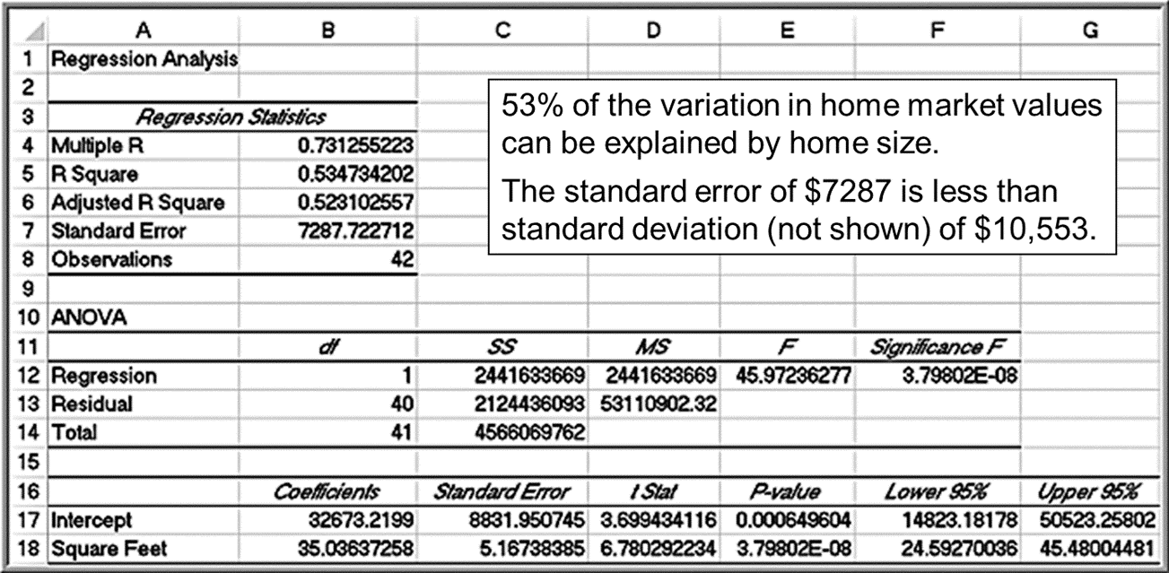
Example 8.6: Interpreting Regression Statistics for Simple Linear Regression

Slide 24
Regression as Analysis of Variance
A N O V A conducts an F - test to determine whether variation in Y is due to varying levels of X.
A N O V A is used to test for significance of regression:
Excel reports the p-value (Significance F).
Rejecting
indicates that X explains variation in Y.

Slide 25

Example 8.7: Interpreting Significance of Regression
Home size is not a significant variable.
Home size is a significant variable.
p-value
Reject
The slope is not equal to zero. Using a
linear relationship, home size is a significant variable in explaining variation in market value.

Slide 26

Testing Hypotheses for Regression Coefficients
An alternate method for testing whether a slope or intercept is zero is to use a t-test:
Excel provides the p-values for tests on the slope and intercept.

Slide 27
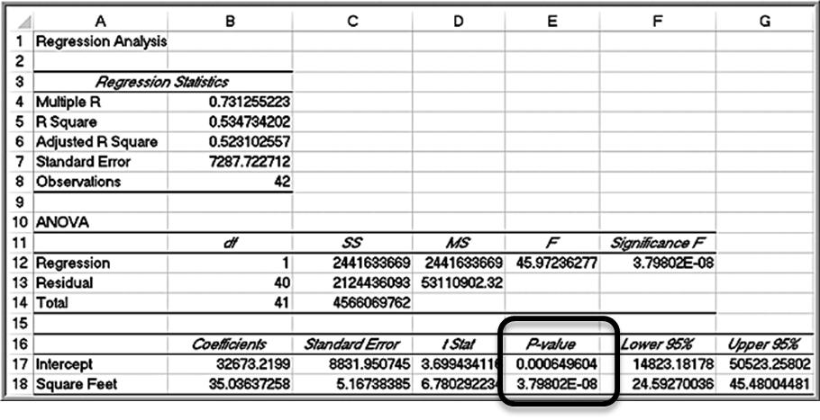
Example 8.8: Interpreting Hypothesis Tests for Regression Coefficients
Use p-values to draw conclusion
Neither coefficient is statistically equal to zero.

Slide 28
Confidence Intervals for Regression Coefficients
Confidence intervals (Lower 95% and Upper 95% values in the output) provide information about the unknown values of the true regression coefficients, accounting for sampling error.
We may also use confidence intervals to test hypotheses about the regression coefficients.
To test the hypotheses
check whether
falls within the confidence interval for
the slope. If it does, reject the null hypothesis.

Slide 29
Example 8.9: Interpreting Confidence Intervals for Regression Coefficients
For the Home Market Value data, a 95% confidence
interval for the intercept is
and for the
slope,
Although we estimated that a house with 1,750 square
feet has a market value of
if the true population parameters are at the extremes of
the confidence intervals, the estimate might be as low as
or as high as

Slide 30
Residual Analysis and Regression Assumptions
Residual = Actual Y value − Predicted Y value
Rule of thumb: Standard residuals outside of
are potential outliers.
Excel provides a table and a plot of residuals.

Slide 31
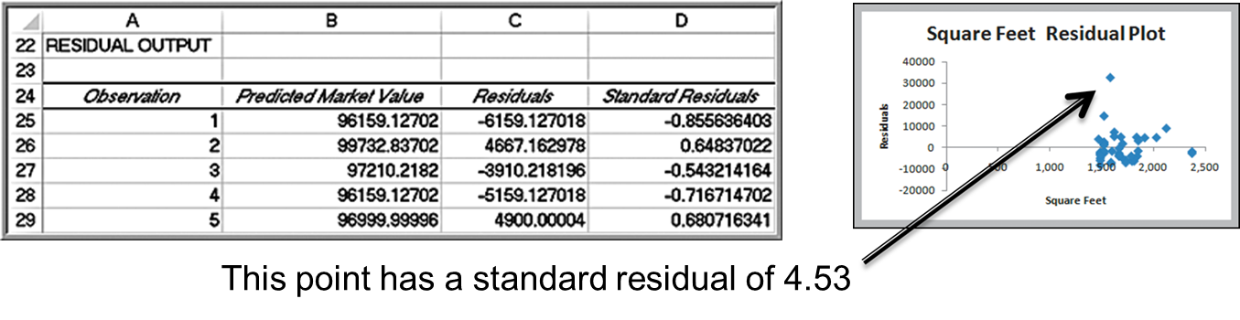
Example 8.10: Interpreting Residual Output
Home Market Value data
The first observation is $90,000 and the regression model predicts $96,159.13. Thus, the residual is 90,000 − 96,159.13 = − $6,159.13.
Identify outliers using standard residuals.

Slide 32
Checking Assumptions
Linearity
examine scatter diagram (should appear linear)
examine residual plot (should appear random)
Normality of Errors
view a histogram of standard residuals
regression is robust to departures from normality
Homoscedasticity: variation about the regression line is constant.
examine the residual plot
Independence of Errors: successive observations should not be related.
This is important when the independent variable is time.

Slide 33
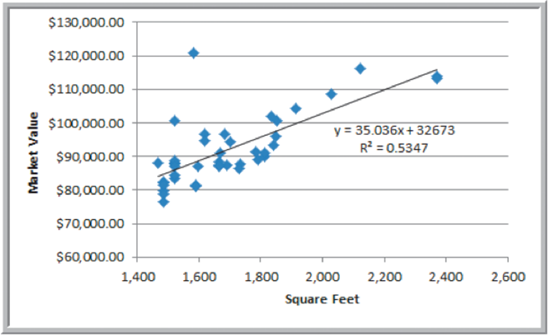
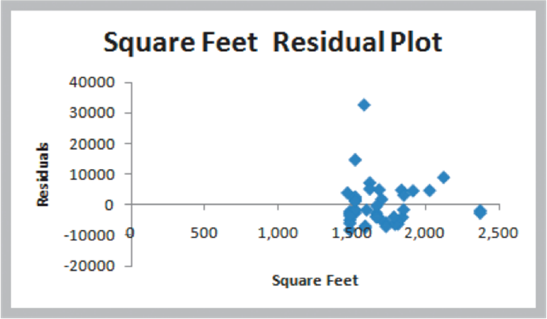
Example 8.11: Checking Regression Assumptions for the Home Market Value Data (1 of 4)
Linearity - linear trend in scatterplot
- no pattern in residual plot

Slide 34
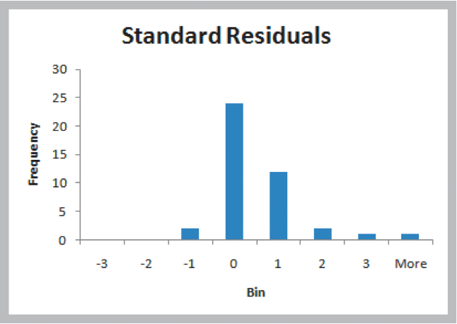
Example 8.11: Checking Regression Assumptions for the Home Market Value Data (2 of 4)
Normality of Errors - residual histogram appears slightly skewed but is not a serious departure.

Slide 35

Example 8.11: Checking Regression Assumptions for the Home Market Value Data (3 of 4)
Homoscedasticity - residual plot shows no serious difference in the spread of the data for different X values.

Slide 36
Example 8.11: Checking Regression Assumptions for the Home Market Value Data (4 of 4)
Independence of Errors - Because the data is cross-sectional, we can assume this assumption holds.

Slide 37
Multiple Linear Regression
A linear regression model with more than one independent variable is called a multiple linear regression model.
where
Y is the dependent variable,
are the independent (explanatory) variables,
is the intercept term,
are the regression coefficients for the independent variables,
is the error term.

Slide 38
Estimated Multiple Regression Equation
We estimate the regression coefficients-called
partial regression coefficients -
then use the model:
The partial regression coefficients represent the expected change in the dependent variable when the associated independent variable is increased by one unit while the values of all other independent variables are held constant.

Slide 39
Excel Regression Tool
The independent variables in the spreadsheet must be in contiguous columns.
So, you may have to manually move the columns of data around before applying the tool.
Key differences:
Multiple R and R Square are called the multiple correlation coefficient and the coefficient of multiple determination, respectively, in the context of multiple regression.
A N O V A tests for significance of the entire model. That is, it computes an F-statistic for testing the hypotheses:

Slide 40
A N O V A for Multiple Regression
A N O V A tests for significance of the entire model. That is, it computes an F-statistic testing the hypotheses:
The multiple linear regression output also provides information to test hypotheses about each of the individual regression coefficients.
If we reject the null hypothesis that the slope associated with independent variable i is 0, then the independent variable i is significant and improves the ability of the model to better predict
the dependent variable. If we cannot reject
then that
independent variable is not significant and probably should not be included in the model.

Slide 41
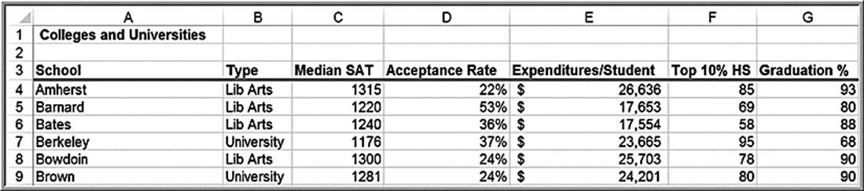
Example 8.12: Interpreting Regression Results for the Colleges and Universities Data (1 of 2)
Predict student graduation rates using several indicators:

Slide 42
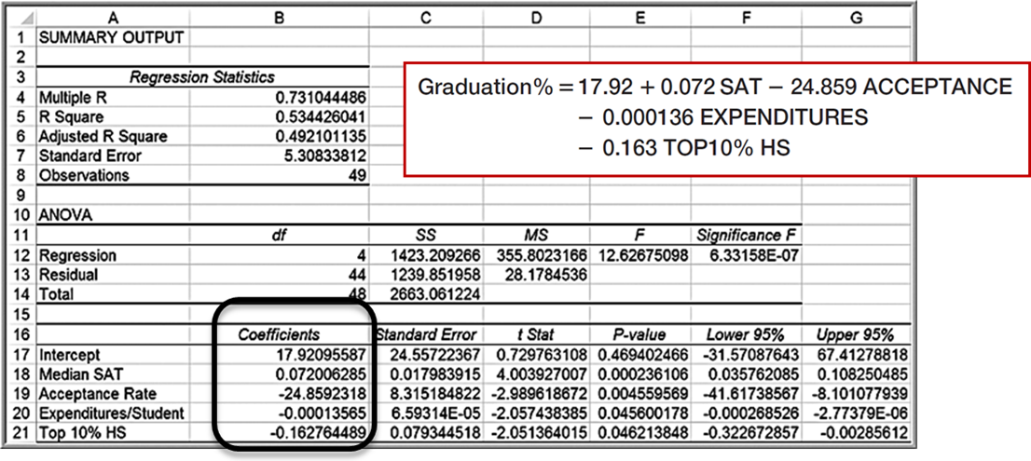
Example 8.12: Interpreting Regression Results for the Colleges and Universities Data (2 of 2)
Regression model
The value of
indicates that 53% of the variation in the dependent
variable is explained by these independent variables.
All coefficients are statistically significant.

Slide 43
Building Good Regression Models
A good regression model should include only significant independent variables.
However, it is not always clear exactly what will happen when we add or remove variables from a model; variables that are (or are not) significant in one model may (or may not) be significant in another.
Therefore, you should not consider dropping all insignificant variables at one time, but rather take a more structured approach.
Adding an independent variable to a regression model will always
result in
equal to or greater than the
of the original model.
Adjusted
reflects both the number of independent variables and the
sample size and may either increase or decrease when an independent
variable is added or dropped. An increase in adjusted
indicates that the
model has improved.

Slide 44
Systematic Model Building Approach
Construct a model with all available independent variables. Check for significance of the independent variables by examining the p-values.
Identify the independent variable having the largest p-value that exceeds the chosen level of significance.
Remove the variable identified in step 2 from the
model and evaluate adjusted
Don’t remove all variables with p-values that exceed a at the same time, but remove only one at a time.)
Continue until all variables are significant.

Slide 45
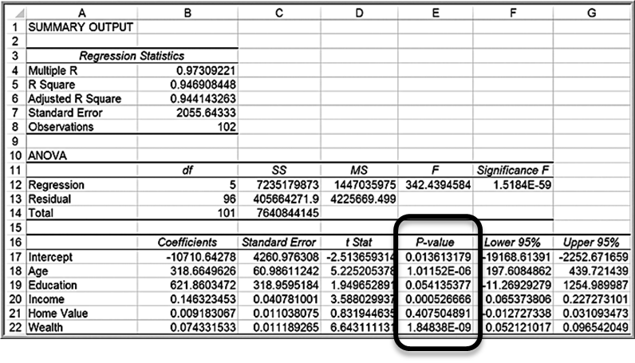
Example 8.13: Identifying the Best Regression Model (1 of 2)
Banking Data
Home value has the largest p-value; drop and re-run the regression.

Slide 46
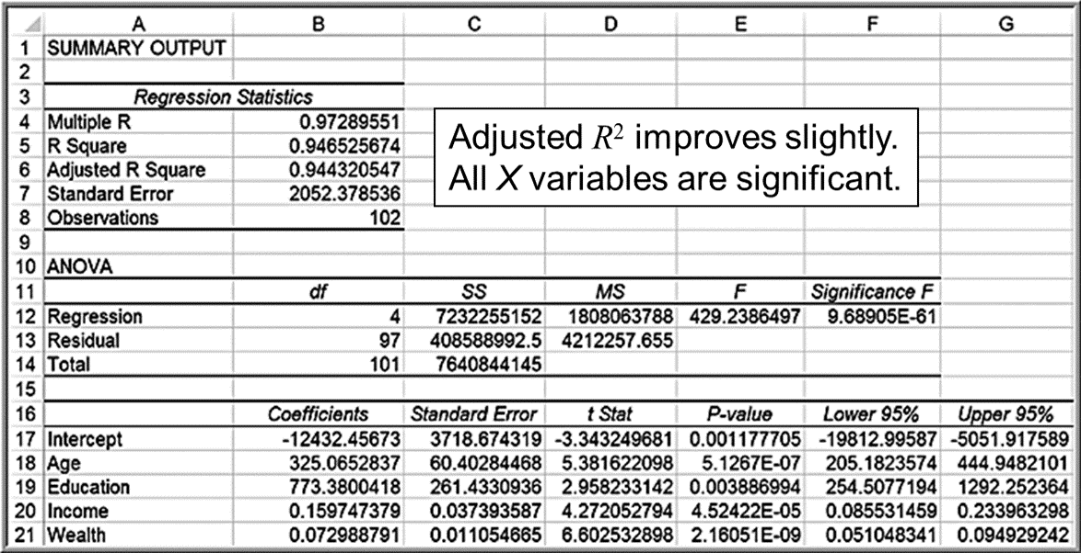
Example 8.13: Identifying the Best Regression Model (2 of 2)
Regression output after removing Home Value

Slide 47
Alternate Criterion
Use the t-statistic.
If
then the standard error will decrease and adjusted
will increase if the variable is removed. If
then
the opposite will occur.
You can follow the same systematic approach, except using t-values instead of p-values.

Slide 48
Multicollinearity
Multicollinearity occurs when there are strong correlations among the independent variables, and they can predict each other better than the dependent variable.
When significant multicollinearity is present, it becomes difficult to isolate the effect of one independent variable on the dependent variable, the signs of coefficients may be the opposite of what they should be, making it difficult to interpret regression coefficients, and p-values can be inflated.
Correlations exceeding
may indicate multicollinearity.
The variance inflation factor is a better indicator, but not computed in Excel.

Slide 49
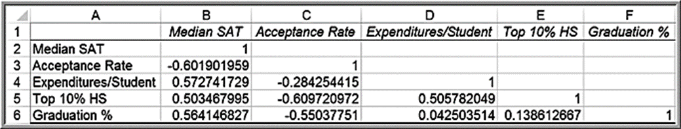
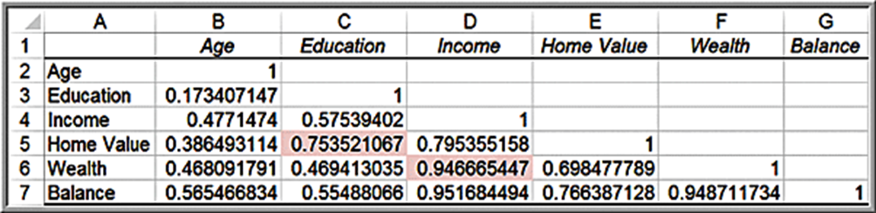
Example 8.14: Identifying Potential Multicollinearity (1 of 2)
Colleges and Universities correlation matrix; none exceed
the recommend threshold of
Banking Data correlation matrix; large correlations exist

Slide 50
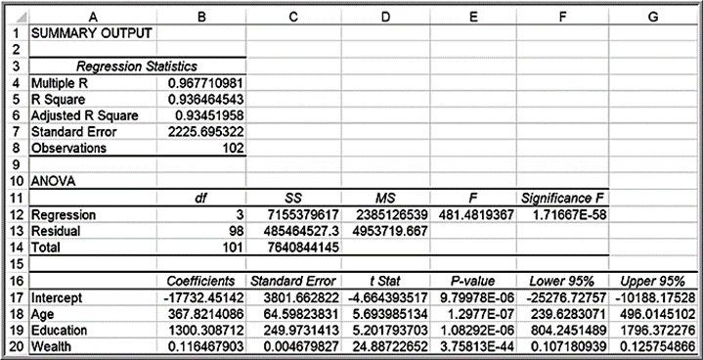
Example 8.14: Identifying Potential Multicollinearity (2 of 2)
If we remove Wealth from the model, the adjusted
drops to
0.9201, but we discover that Education is no longer significant.
Dropping Education and leaving only Age and Income in the model
results in an adjusted
of 0.9202.
However, if we remove Income from the model instead of Wealth, the
Adjusted
drops to only 0.9345, and all remaining variables
(Age, Education, and Wealth) are significant.

Slide 51
Practical Issues in Trendline and Regression Modeling
Identifying the best regression model often requires experimentation and trial and error.
The independent variables selected should make sense in attempting to explain the dependent variable.
Logic should guide your model development. In many applications, behavioral, economic, or physical theory might suggest that certain variables should belong in a model.
Additional variables increase
and, therefore, help to explain a larger
proportion of the variation.
Even though a variable with a large p-value is not statistically significant, it could simply be the result of sampling error and a modeler might wish to keep it.
Good models are as simple as possible (the principle of parsimony).

Slide 52
Overfitting
Overfitting means fitting a model too closely to the sample data at the risk of not fitting it well to the population in which we are interested.
In fitting the crude oil prices in Example 8.2, we noted that the
value will increase if we fit higher-order polynomial functions to the data. While this might provide a better mathematical fit to the sample data, doing so can make it difficult to explain the phenomena rationally.
In multiple regression, if we add too many terms to the model, then the model may not adequately predict other values from the population.
Overfitting can be mitigated by using good logic, intuition, theory, and parsimony.

Slide 53
Regression with Categorical Variables
Regression analysis requires numerical data.
Categorical data can be included as independent variables, but must be coded numeric using dummy variables.
For variables with 2 categories, code as 0 and 1.

Slide 54
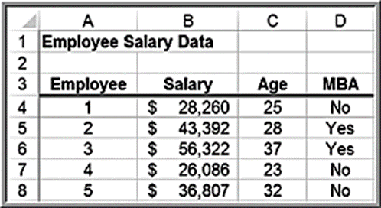
Example 8.15: A Model with Categorical Variables (1 of 2)
Employee Salaries provides data for 35 employees.
Predict Salary using Age and M B A (code as yes = 1, no = 0)
where
Y = salary

Slide 55
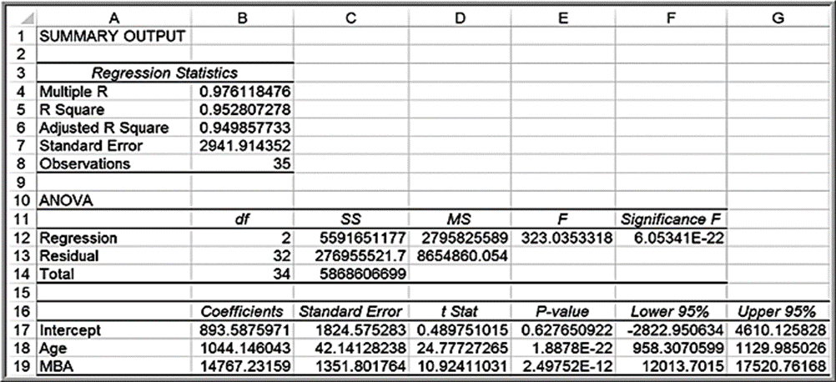
Example 8.15: A Model with Categorical Variables (2 of 2)
Salary
If M B A = 0, salary
If M B A = 1, salary

Slide 56
Interactions
An interaction occurs when the effect of one variable is dependent on another variable.
We can test for interactions by defining a new variable as the product of the two variables,
and testing whether this
variable is significant, leading to an alternative model.

Slide 57
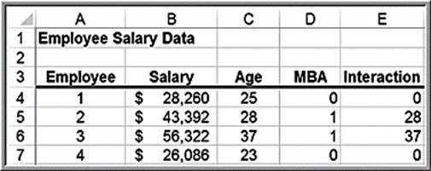
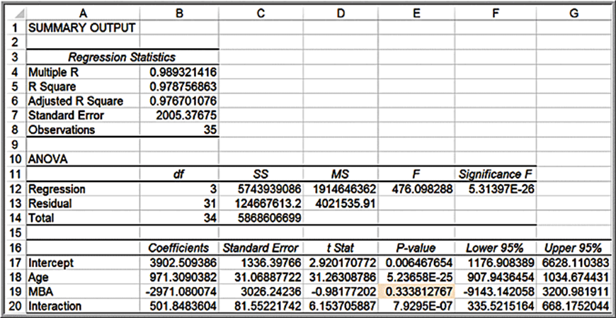
Example 8.16: Incorporating Interaction Terms in a Regression Model (1 of 3)
Define an interaction between Age and M B A and re-run the regression.
The M B A indicator is not significant; we would typically drop it and re-run the regression analysis.

Slide 58
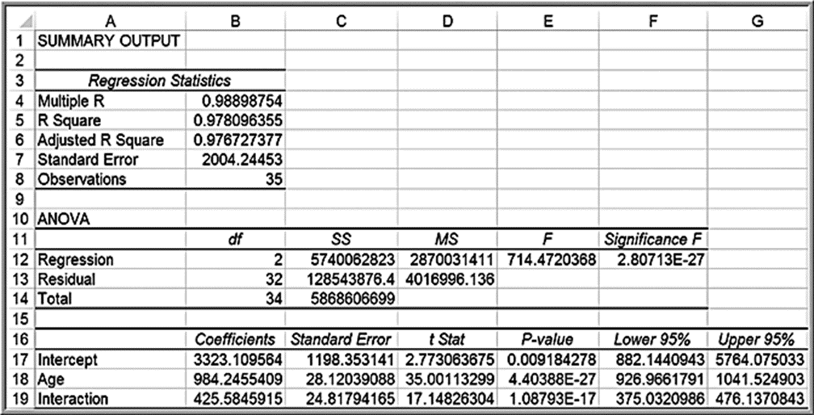
Example 8.16: Incorporating Interaction Terms in a Regression Model (2 of 3)
This results in the model:

Slide 59
Example 8.16: Incorporating Interaction Terms in a Regression Model (3 of 3)
However, statisticians recommend that if interactions are significant, first-order terms should be kept in the model regardless of their p-values.
Thus, using the first regression model, we have:

Slide 60
Categorical Variables with More Than Two Levels
When a categorical variable has k > 2 levels, we need to add k − 1 additional variables to the model.

Slide 61
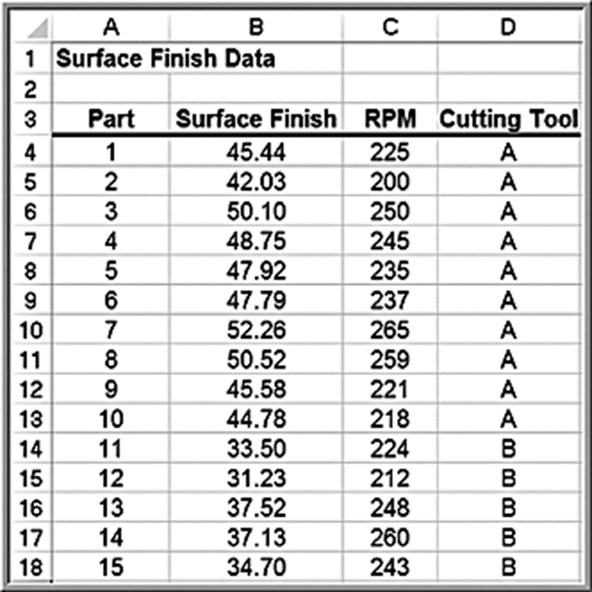
Example 8.17: A Regression Model with Multiple Levels of Categorical Variables (1 of 4)
The Excel file Surface Finish provides measurements of the surface finish of 35 parts produced on a lathe, along with the revolutions per minute (R P M) of the spindle and one of four types of cutting tools used.

Slide 62
Example 8.17: A Regression Model with Multiple Levels of Categorical Variables (2 of 4)
Because we have k = 4 levels of tool type, we will define a regression model of the form
where
Y = surface finish

Slide 63
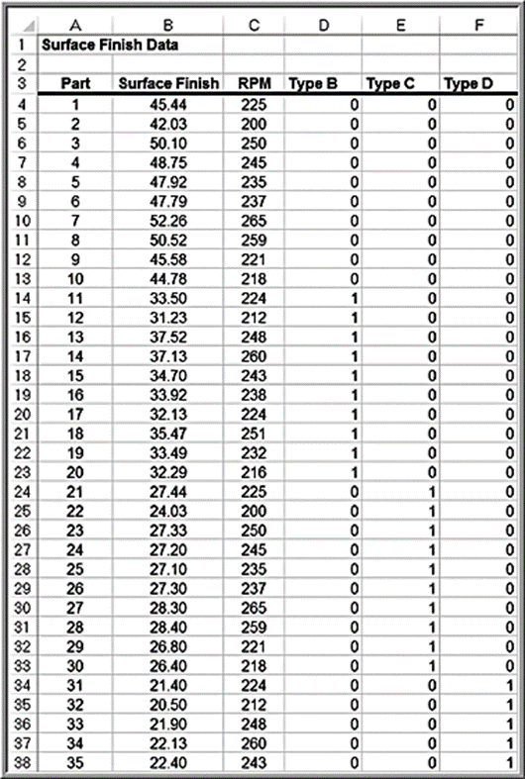
Example 8.17: A Regression Model with Multiple Levels of Categorical Variables (3 of 4)
Add 3 columns to the data, one for each of the tool type variables

Slide 64
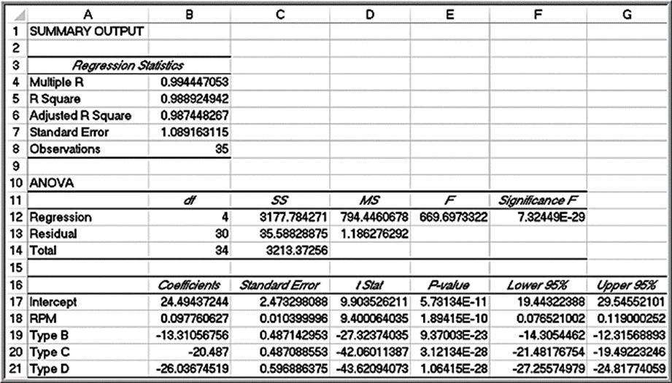
Example 8.17: A Regression Model with Multiple Levels of Categorical Variables (4 of 4)
Regression results
Surface finish = 24.49 + 0.098 R P M − 13.31 type B − 20.49 type C − 26.04 type D

Slide 65
Regression Models with Nonlinear Terms
Curvilinear models may be appropriate when scatter charts or residual plots show nonlinear relationships.
A second order polynomial might be used
Here
represents the linear effect of X on Y and
represents the curvilinear effect.
This model is linear in the β parameters so we can use linear regression methods.

Slide 66
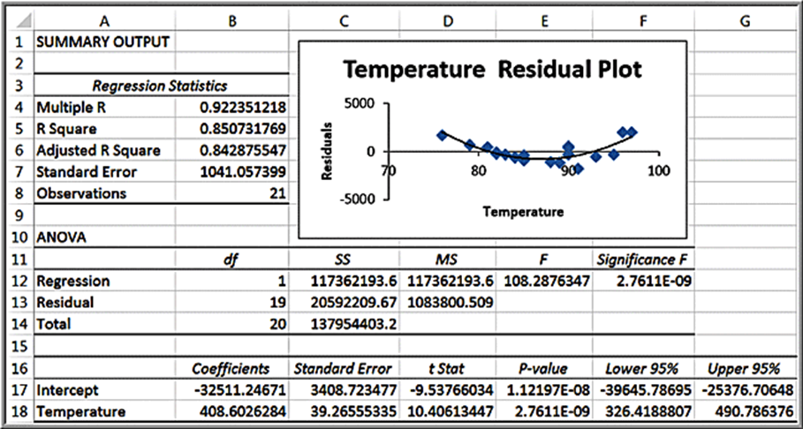
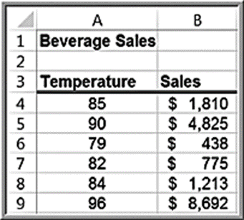
Example 8.18: Modeling Beverage Sales Using Curvilinear Regression (1 of 2)
The U-shape of the residual plot (a second-order polynomial trendline was fit to the residual data) suggests that a linear relationship is not appropriate.

Slide 67
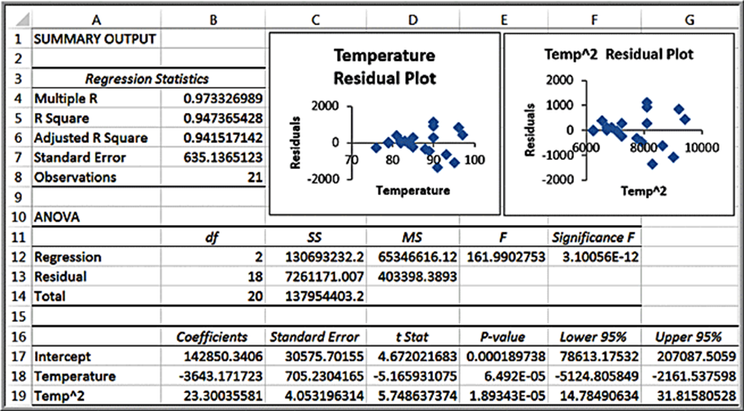
Example 8.18: Modeling Beverage Sales Using Curvilinear Regression (2 of 2)
Add a variable for temperature squared.
The model is:

